Slide 1
LINUX GRAPHICS STACK
An Introduction

Slide 2
In the early times there was only a single piece of software that had direct access to the graphics hardware: the X server.
Simple Graphics Stack
No need to synchronize access to the graphics hardware between multiple clients.
Applications would do all their drawing indirectly, through the X server.
Using Xlib they would send rendering commands over the X11 protocol that the X server would receive, process and translate to actual hardware commands on the other side of a socket.

Slide 3
“Translation” a driver’s job:
Taking a bunch of hardware agnostic rendering commands as its input and translating them into hardware commands as expected by the targeted GPU.
By design X server being the only piece of software that could talk to the graphics hardware, userspace drivers (DDX) written specifically for it, became modules of the X server and an integral part of its architecture.
DDX role in the graphics stack is to support 2D operations as exported by Xlib and required by the X server implementation.

Slide 4
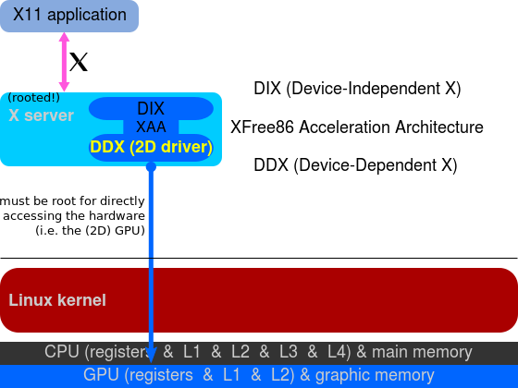
DDX drivers in the X server

Slide 5
3D graphics
Indirect Rendering
3D graphics is implemented via OpenGL through a libGL.so
a hardware accelerated libGL.so that talked directly to the 3D hardware not possible.
Reason: Sole access to graphics hardware only through X server
solution was to provide an implementation of OpenGL that would send OpenGL commands to the X server through an extension of the X11 protocol and let the X server translate these into actual hardware commands as done for 2D commands.

Slide 6
3D graphics
solution was not sufficient for intensive 3D applications, such as games, that required to render large amounts of 3D primitives while maintaining high frame rates. The problem was clear: wrapping OpenGL calls in the X11 protocol was not a valid solution.
In order to achieve good performance in 3D applications we needed these to access the hardware directly and that would require to rethink a large chunk of the graphics stack.

Slide 7
3D graphics
Solution not suitable for intensive 3D applications, such as games, requiring rendering of large amounts of 3D primitives while maintaining high frame rates.
wrapping OpenGL calls in the X11 protocol inefficient.
Good 3D performance possible only through direct access to the graphics hardware requiring large scale rework of the graphics stack.

Slide 8
Direct Rendering Infrastructure (DRI)
New architecture that allows X clients to talk to the graphics hardware directly.
Implementation requires changes to various parts of the graphics stack including the X server, the kernel and various client libraries.

Slide 9
Direct Rendering Manager (DRM)
An important DRI component.
Kernel side of the DRI architecture
Kernel handles sensitive aspects like hardware locking, access synchronization, video memory and more.
provides userspace with an API to submit commands and data in a format compatible with modern GPUs.
effectively allows userspace to communicate directly with the graphics hardware.
target hardware specific drivers → different DRM drivers for each GPU.

Slide 10
MESA
DRI/DRM provide the building blocks that enable userspace applications to access the graphics hardware directly in an efficient and safe manner
To use OpenGL another software component ( MESA) that uses the DRI/DRM infrastructure, to implement the OpenGL API while respecting the X server requirements needed.

Slide 11
MESA
A free software implementation of the OpenGL specification
Provides a libGL.so, which OpenGL based programs can use to output 3D graphics in Linux.
Can provide accelerated 3D graphics by taking advantage of the DRI architecture to gain direct access to the underlying graphics hardware in its implementation of the OpenGL API.

Slide 12
When 3D application runs in an X11 environment it will output its graphics to a surface (window) allocated by the X server but without intervention of the X server using DRI.
Synchronization needed between OpenGL application and X server since X server still owns the window Mesa is rendering to and is responsible for displaying window contents on the screen.

Slide 13
Synchronization between the OpenGL application and the X server is part of DRI.
Mesa’s implementation of GLX (the extension of the OpenGL specification that addresses the X11 platform) uses DRI to talk to the X server and accomplish this.

Slide 14
Communication with the graphics hardware happens by sending commands (for example “draw a triangle”) and data (for example the vertex coordinates of the triangle, their color attributes, normals, etc).
This process involves allocating a bunch of buffers in the graphics hardware where all these commands and data are copied so that the GPU can access them and do its work.
DRM driver provides the support

Slide 15
DRM
DRM driver takes care of managing video memory in a target hardware specific manner and offers APIs to userspace (Mesa).
DRM is also required whenever we need to allocate and manage video memory in Mesa, so things like creating textures, uploading data to textures, allocating color, depth or stencil buffers, etc all require to use the DRM APIs for the target hardware.

